Slide 1
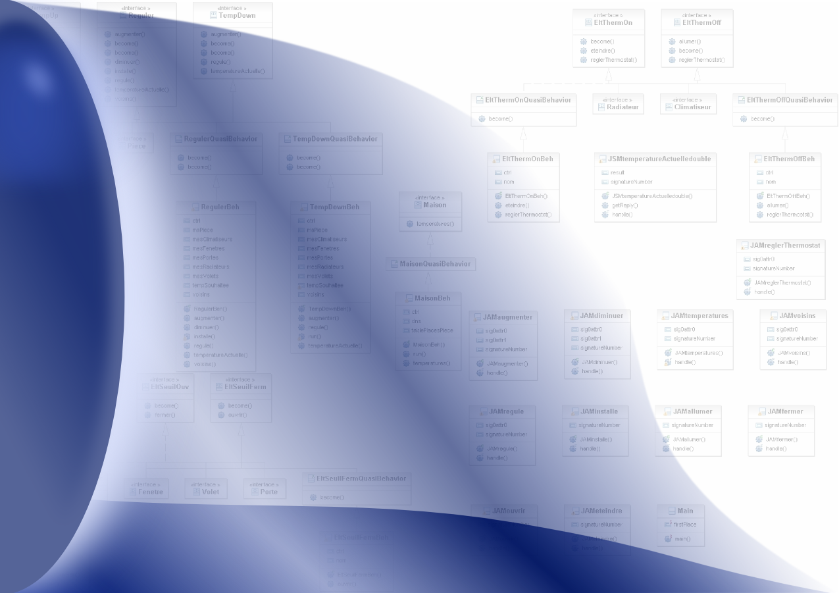
Model Driven Engineering for Designing
Adaptive Multi-Agent Systems
Sylvain Rougemaille, Frédéric Migeon,
Christine Maurel and Marie-Pierre Gleizes
SMAC Team - IRIT
http://www.irit.fr/SMAC
Paul Sabatier University – Toulouse – France

Slide 2
Outline
Context
  Adaptive Multi-Agent Systems
  JavAct : an Agent Middleware
Focus of this presentation
  Adaptation
  Model-Driven Engineering
Semi-Automatic Transformation
Conclusion and Perspectives

Slide 3
Adaptive Systems
Adapt their behaviour in order to react towards the environment dynamic
  ⬅ Achieve its task
  Improve their functioning (Robertson 2000)
Inspiration from natural systems
⬅ self-organisation
social animals like ants, termite,…

Slide 4
Self-Organization & Emergence
Self-organisation is a process in which pattern at the global level of a system emerges solely from numerous interactions among the lower level components of the system [Camazine, 2001]
A phenomenon is emergent if and only if we have:
  A system of interacting entities whose states and dynamics is expressed in a theory D
  The production of a phenomenon (a process, a stable state, an invariant) which is global relative to the former system
  The interpretation of the phenomenon via an inscription mechanism in another theory D’ [Müller, ESAW2004]
Emergent Self-Organisation
= “result” of the collective = means to obtain
emergent phenomenon

Slide 5
Self-Organization in Artificial Systems
The mechanism or the process enabling a system to change its organisation without explicit external control during its execution time [DiMarzo, Gleizes, Karageorgos TFGSO 2005]
Find a solution = find the right organisation
…
Solving process = succession of organizations (Edmonds, 2005) (Living Design in Picard 2003)
Problem Solving: Agents interact and evolve in a common environment
  Design – Local Level and Evaluation – Global Level
  Agents: Local behavioural rules(policies, meta-norms?), Local perceptions

Slide 6
AMAS (Adaptive Multi-Agent Systems) Theory (Glize, 2000)(Gleizes, EEMMAS2007)
Adaptive systems - Problem solving
Adequate function = what the system has to do to be « useful »
Global function realized = result of the organizational process between agents
Change the organization ➔ change the global function
To change the organization : self-organization by cooperation
Adequate function when all agents are in a cooperative state

Slide 7
AMAS Theory:
Non Cooperative Situations (1/2) (Capera, 2003)
COOPERATION POLICY
ANTICIPATION: try to avoid “problems”
  It tries to avoid Non Cooperative Situations which can be anticipated by itself
EXCEPTION TREATEMENTS : “detection and handler execution”
  It detects and repairs Non Cooperative Situations
An agent must have a cooperative attitude
If all is OK ➔ execute its nominal behaviour
If Non cooperative state ➔ recover the cooperation failure
  It always tries to be cooperative BUT an agent is benevolent and not altruistic ➔ sometimes Non Cooperative Situations occur
…

Slide 8
Non Cooperative Situations (2/2)
Definition of a cooperative situation from the local point of view of an agent
  All perceived signals must be understood without ambiguity
    Incomprehension
    Ambiguity
  The received information is useful for the agent’s reasoning
    Unproductiveness
    Incompetence
  Reasoning leads to useful actions towards others
    Conflicts
    Concurrency
    Uselessness

Slide 9
Overview
Designing tools:
Code Generation
Graphical Modelisation
Prototypes
Tests
Simulations
Validations
Specific
MAS Designing:
Adaptive MAS
Specific
Agent Middleware:
JavAct
Description of
MAS Designing
Description of
(Semi-)Automatic Transformations
Description of
Middleware
MODEL-DRIVEN ENGINEERING

Slide 10
Extension of ADELFE Methodology
New CASE tool based on MDE
Enriching ADELFE* development phase
Methodology for AMAS design
Based on Rational Unified Process
(* http://www.irit.fr/ADELFE/)

Slide 11
AMAS
Two important aspects of MAS :
  the functional aspect : application dependent, ~decision process of agents
    e.g. how an ant agent changes its orientation when in front of a wall
  the operational aspect : elementary skills of agents
    e.g. the way how the ant agent perceives the wall depends on the implementation of the environment

Slide 12
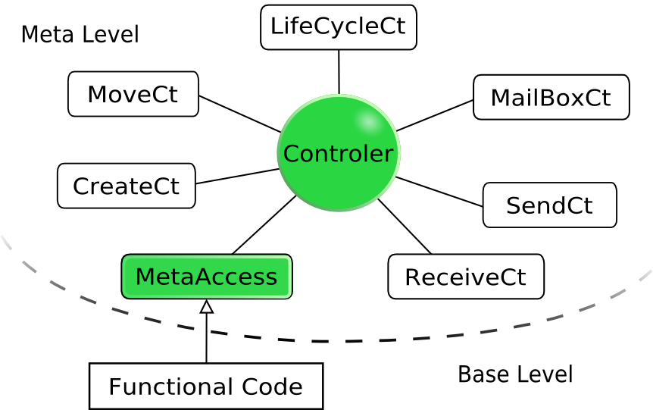
Functional/Operational Adaptation
Self-adaptation of the system = cooperation of agents
Non Cooperative Situations detection
Implementation with JavAct* middleware
 | Functional Adaptation | Operational Adaptation
Agent | Classical learning approaches | JavAct
System | AMAS approach
different kinds of adaptation, different levels of concerns
(* http://javact.org/)

Slide 13
MDE Tools
Generalize use of models described by meta-models
  MOF (OMG), Ecore (Eclipse)
Generated model editing graphical tools
  Topcased* (AESE), GMF (Eclipse)
Model transformation tools
  ATL†, Kermeta‡
(* http://www.topcased.org/)
(† http://www.eclipse.org/m2m/atl/)
(‡ http://www.kermeta.org/)

Slide 14
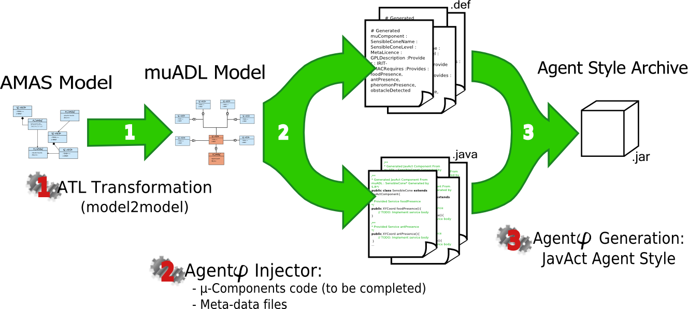
Transformations Overview

Slide 15
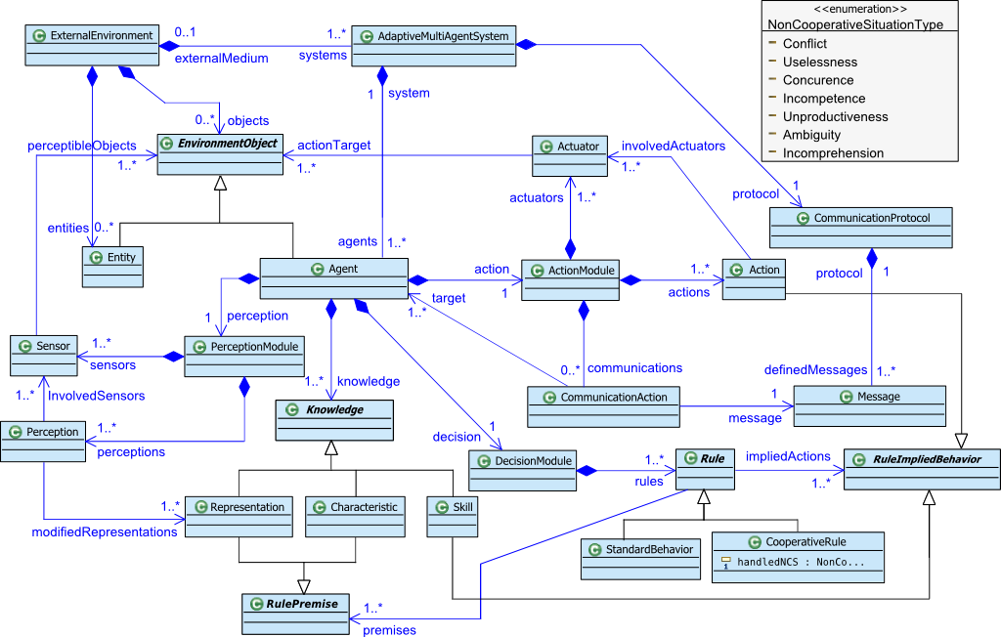
AMAS-ML : AMAS Meta-Model
System & Agent points of view (+ NCS taxonomy)

Slide 16
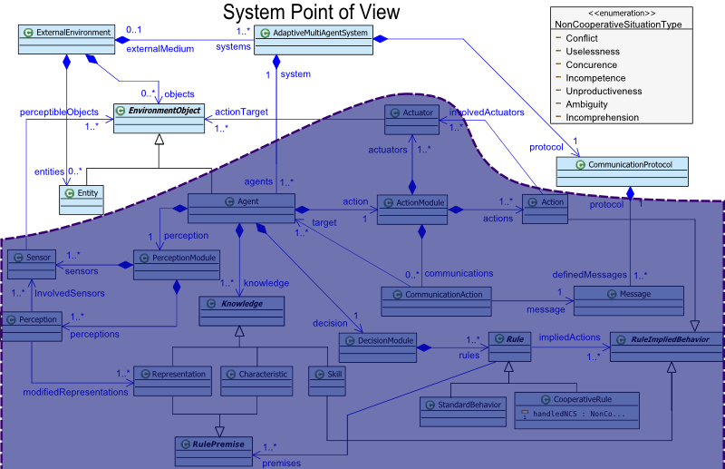

Slide 17
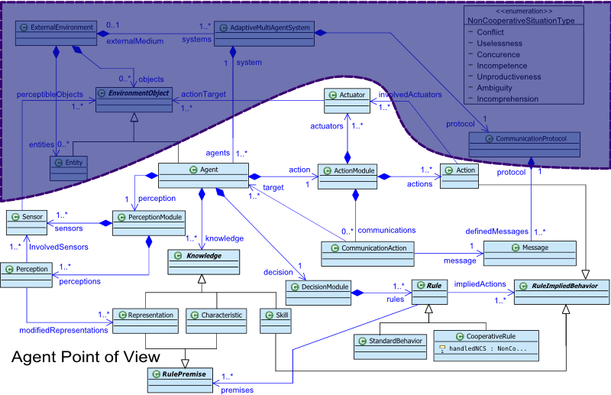

Slide 18
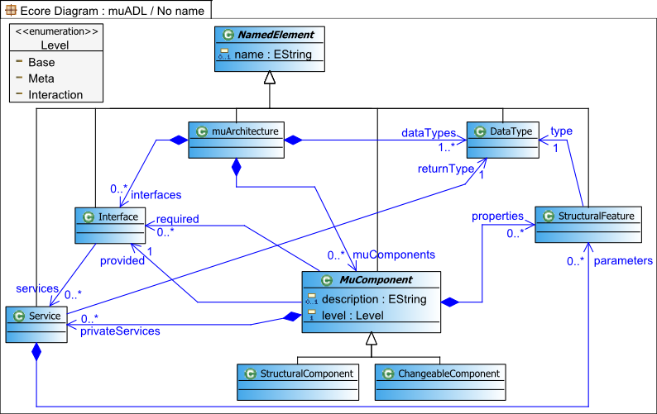
μADL Meta-Model
Micro-architecture
Description Language
  Abstraction of JavAct micro-architecture

Slide 19
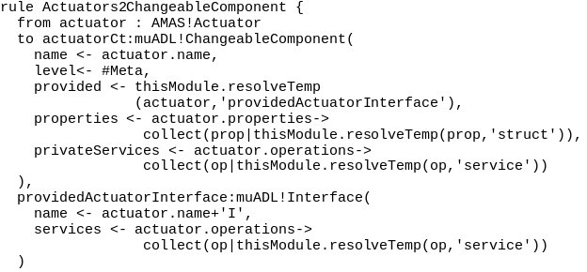
Mapping Process
1 single transformation =
  1 main rule (200 lines) & 11 auxiliary rules (3 lines each)
1 example

Slide 20
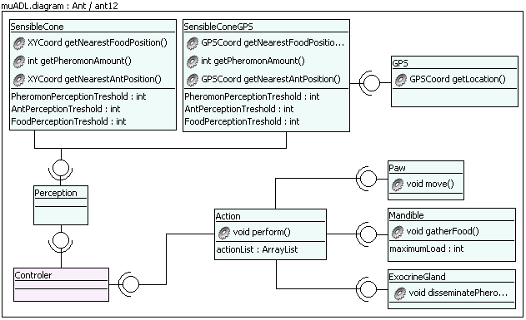
Ants Example

Slide 21
Conclusion and Perspectives
Designing tools:
Code Generation
Graphical Modelisation
Prototypes
Tests
Simulations
Validations
Specific
MAS Designing:
Adaptive MAS
Specific
Agent Middleware:
JavAct
Description of
MAS Designing
Description of
(semi-)automatic transformations
Description of
Middleware
MODEL-DRIVEN ENGINEERING

